Slide 1


Restaurant Recommender System

Slide 2

Introduction
Problem Background:
- Bangalore, India’s third-largest city, offers a diverse culinary experience.
- Travelers often face challenges in finding good, affordable restaurants.
Problem Description:
- Need to recommend the right restaurant based on proximity, ratings, cost, and specialties.

Slide 3
Questions to Address
How many types of food are available in restaurants?
Which is the nearest restaurant with a good rating?
How many similar restaurants are nearby?
Do similar restaurants cost more, and what makes them special?

Slide 4
Target Audience
Travelers and local residents seeking restaurant recommendations.
People who prefer similar restaurants or highly rated options near them.

Slide 5
Data
Data Requirements:
-Restaurant coordinates (latitude, longitude).
- Population and income of neighborhoods.
Data Collection:
- Used Google Maps API for coordinates, and web scraping for neighborhood data.

Slide 6
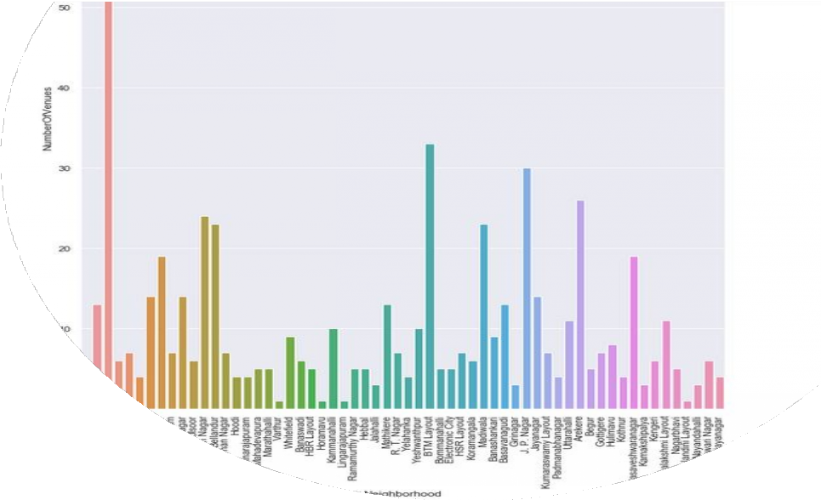



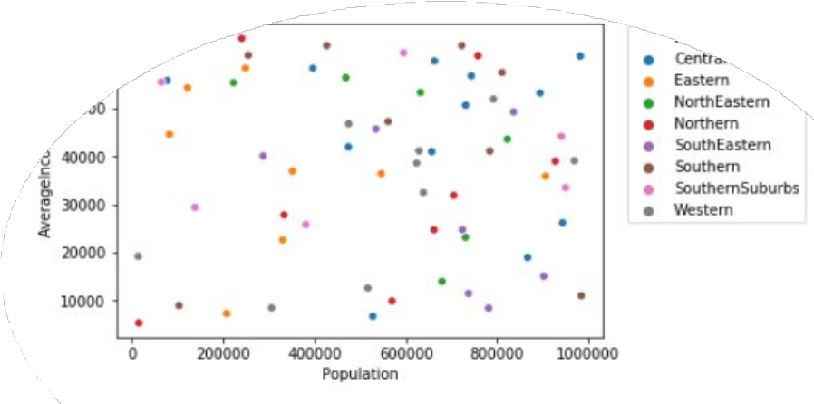

METHODOLOGY
Machine learning
Exploratory analysis
Recommender System
Inferential analysis

Slide 7
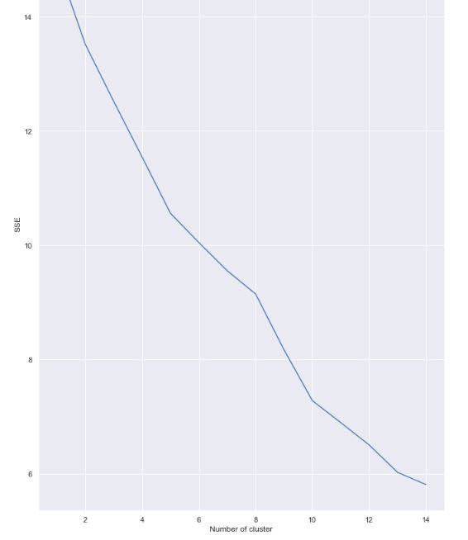
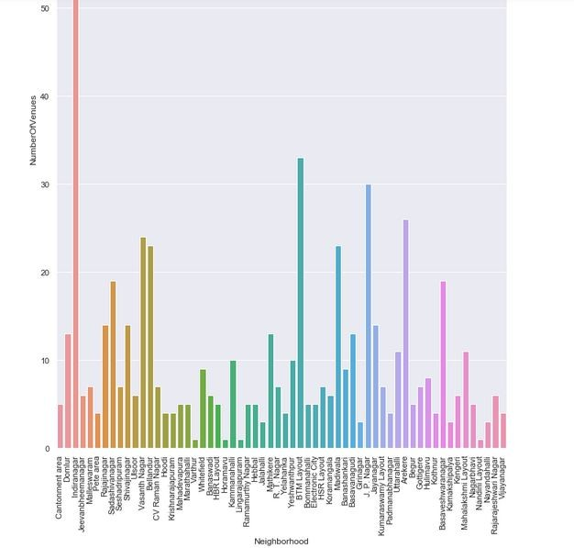

Slide 8
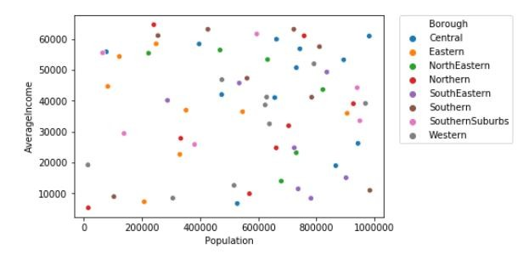

Slide 9
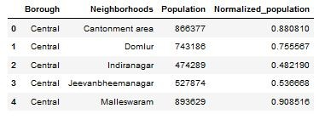
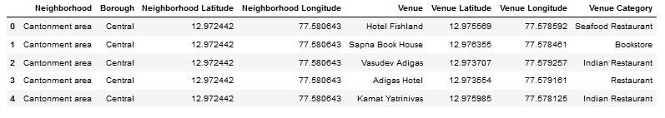
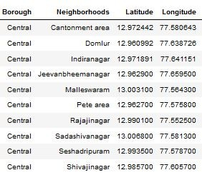
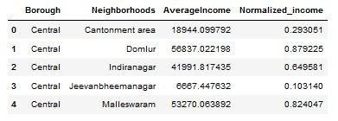
DATASETS

Slide 10


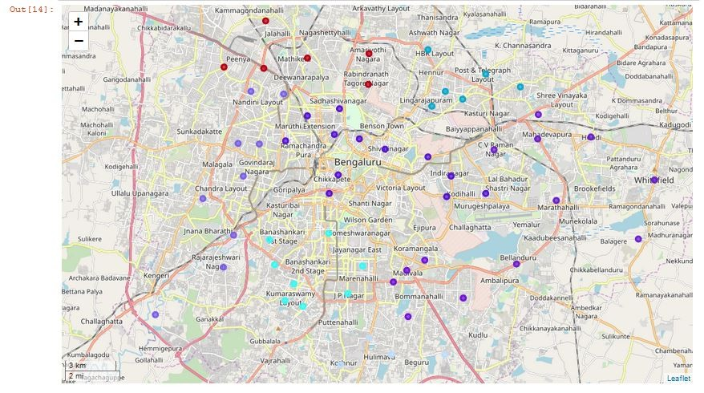
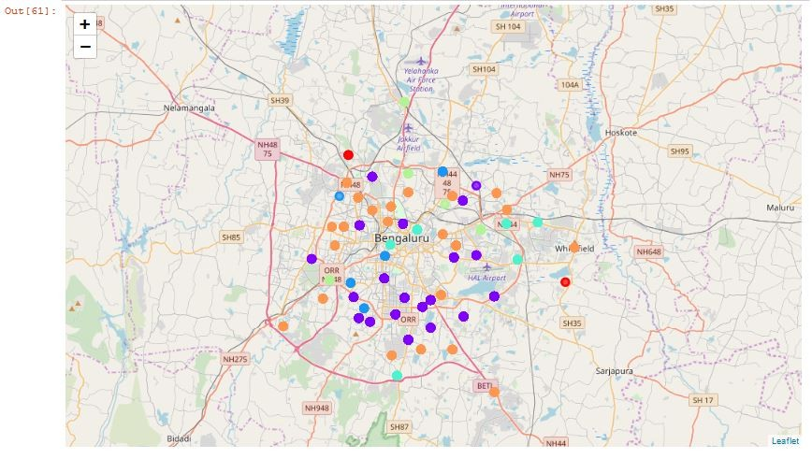
MAPPING AND CLUSTERING

Slide 11
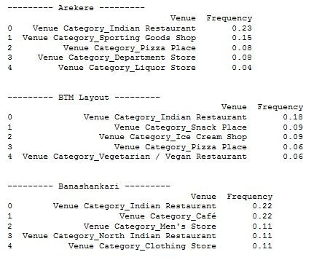
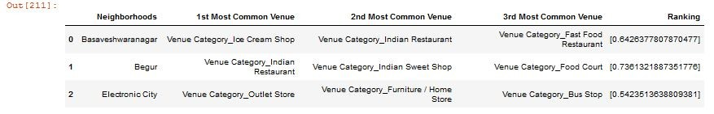
RESULTS AND CONCLUSION

Slide 12
Clustering
Used clustering methods to group similar neighborhoods.
Elbow graph helped determine the optimal number of clusters.

Slide 13
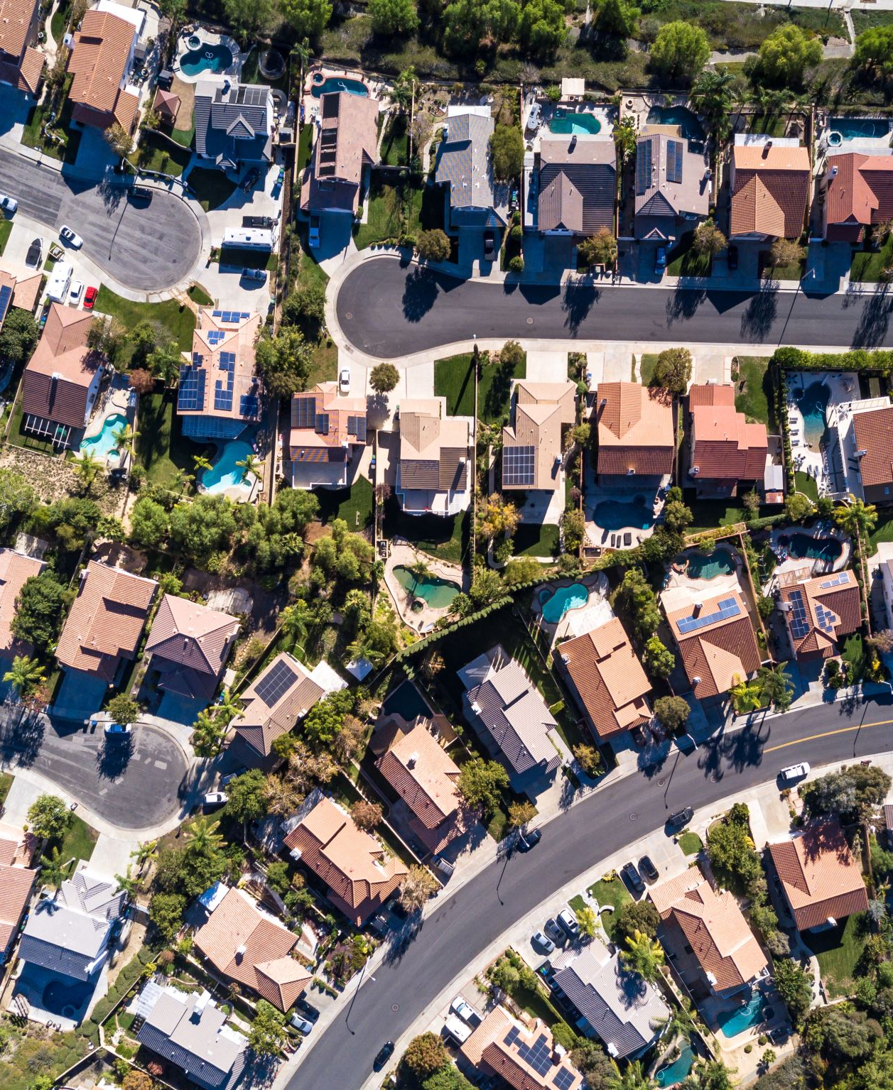
Results
Example of neighborhood 'Whitefield':
Model recommended neighborhoods with similar characteristics.

Slide 14
Discussion
Nonlinear relationships between population and income impact clustering.
Correct number of clusters is crucial to avoid overfitting or underfitting.

Slide 15
Conclusion
Recommender system helps users find the best restaurant based on population, income, and Foursquare API data.
The system's accuracy improves with more data.

